Slide 1

Product Design And Development
Presented by
Chandan Maurya
(2502103017)
Pratham Shrivastava
(2502103024
Presented to
Dr. Pawan Kumar Kankar Professor
IIT Indore

Slide 2
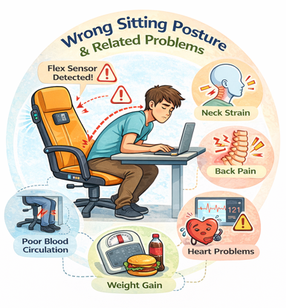
OPPORTUNITY IDENTIFICATION
In the modern lifestyle, students, office workers, gamers, and professionals spend long hours sitting on chairs while studying or working. Continuous sitting with incorrect posture leads to serious health problems such as back pain, neck strain, spinal disorders, obesity, reduced blood circulation, and heart-related risks.

Slide 3
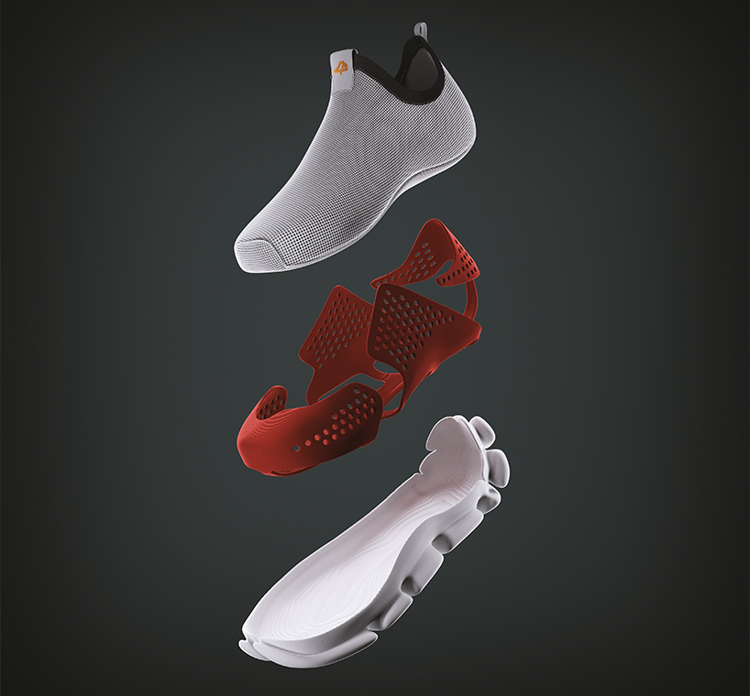
Conventional shoes have fixed sizes, which leads to:
Size mismatch for growing feet (children)
Discomfort due to swelling during long walking
Inventory issues for manufacturers
Shoe wastage due to minor size variation

Slide 4

In rural areas, people often carry heavy agricultural or household loads using traditional sacks (sag/bora).
These sacks are uncomfortable, lack proper weight distribution, and can cause shoulder and back pain.
At the same time, normal bags are not suitable for carrying heavy loads.
Therefore, there is a need for a convertible carrying system that can function as:
A comfortable backpack for light loads
A strong sack-type carrier for heavy loads

Slide 5
SELECTED OPPORTUNITY
In the modern lifestyle, students, office workers, gamers, and professionals spend long hours sitting on chairs while studying or working. Continuous sitting with incorrect posture leads to serious health problems such as back pain, neck strain, spinal disorders, obesity, reduced blood circulation, and heart-related risks.
Additionally, people often forget to take breaks, drink sufficient water, or maintain proper body posture, which negatively affects their productivity, comfort, and long-term health. Existing chairs are mostly passive furniture and do not provide any active health monitoring or real-time feedback system.

Slide 6
OBJECTIVE
The main objectives of designing the Smart Chair are:
To detect and improve sitting posture using posture sensing system.
To reduce sedentary lifestyle risk by giving periodic movement reminders.
To promote proper hydration habits by providing drinking water alerts.
To monitor basic heart rate for user health awareness.
To provide thermal comfort using cooling fan and heating coil.
To improve work efficiency, comfort, and long-term physical health of the user.

Slide 7
NEED ANALYSIS
Sr.No | NEED ANALYSIS | Rating
1 | The chair should help the user maintain correct sitting posture to prevent back and neck pain | 10
2 | The system should provide sedentary reminders to encourage regular movement and reduce health risks | 9
3 | The chair should include a drinking water reminder to promote proper hydration habits | 8
4 | The chair should monitor heart rate to create basic health awareness during long sitting periods | 8
5 | The chair should provide thermal comfort through cooling fan and heating system | 7
6 | The chair should have ergonomic cushioning and comfortable body support for long duration sitting | 9

Slide 8
Continued…
7 | The system should be energy efficient and safe for continuous operation | 8
8 | The system should be easy to use and user-friendly for students and office workers | 9
9 | The design should be low cost and affordable for common users | 7
10 | The chair should be compact and suitable for home, office and classroom environments | 8

Slide 9
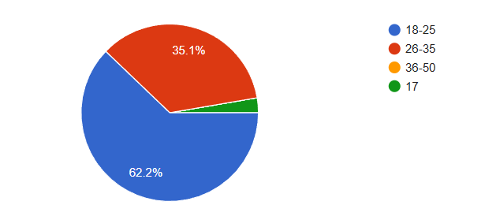
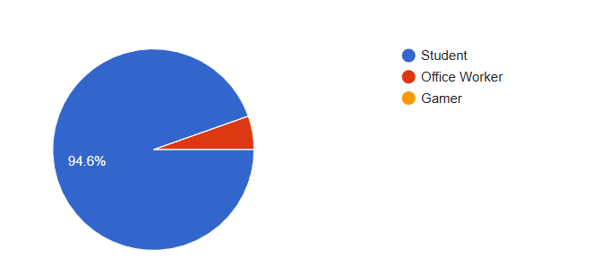
Age group
Occupation

Slide 10
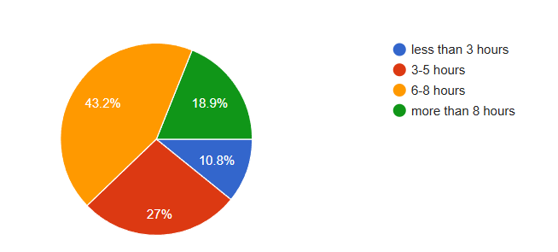
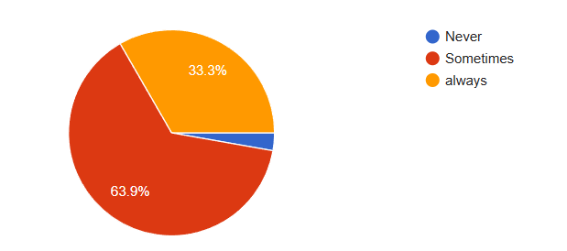
How many Hours do you sit daily?
How often do you sit in wrong posture?

Slide 11
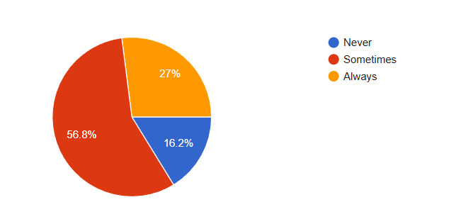
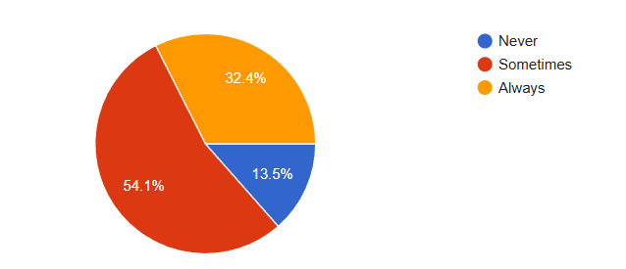
Do you sit continuously for long periods without breaks?
How often do you forget to drink water while working/studying?

Slide 12
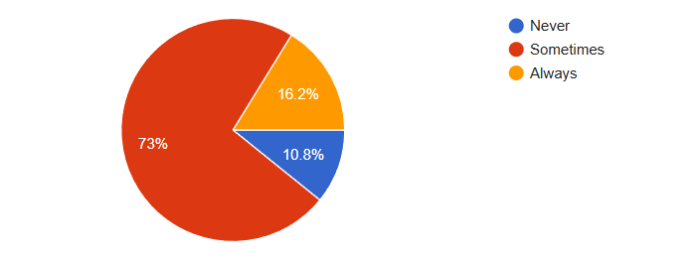
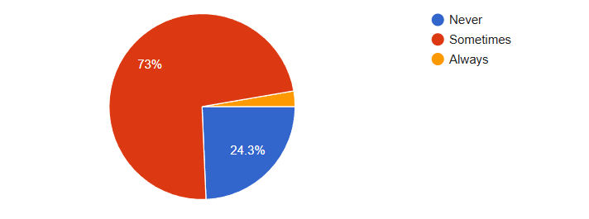
Any kind of discomfort due to temperature while sitting?
Do you experience any kind of Increased heart rate, Feeling tired or discomfort ?

Slide 13
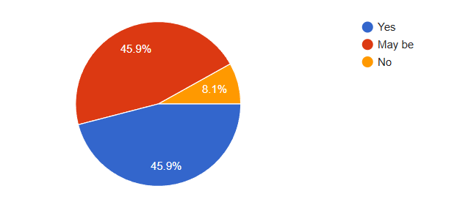
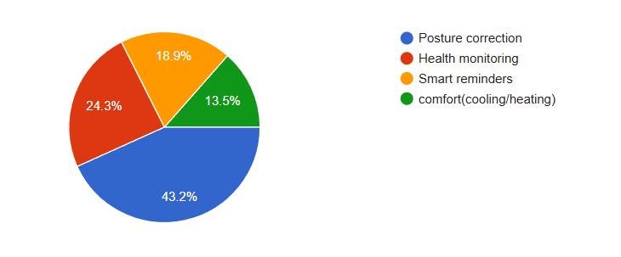
Would you be interested in buying a Smart Health Chair?
Which feature would influence your decision the most?

Slide 14
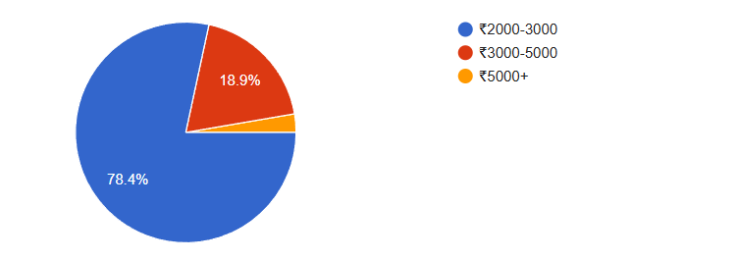
How much you are willing to pay?

Slide 15
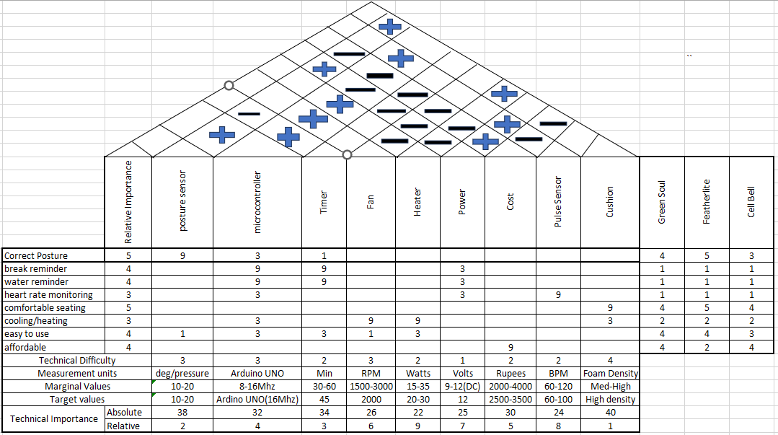
QUALITY FUNCTION DEPLOYMENT

Slide 16
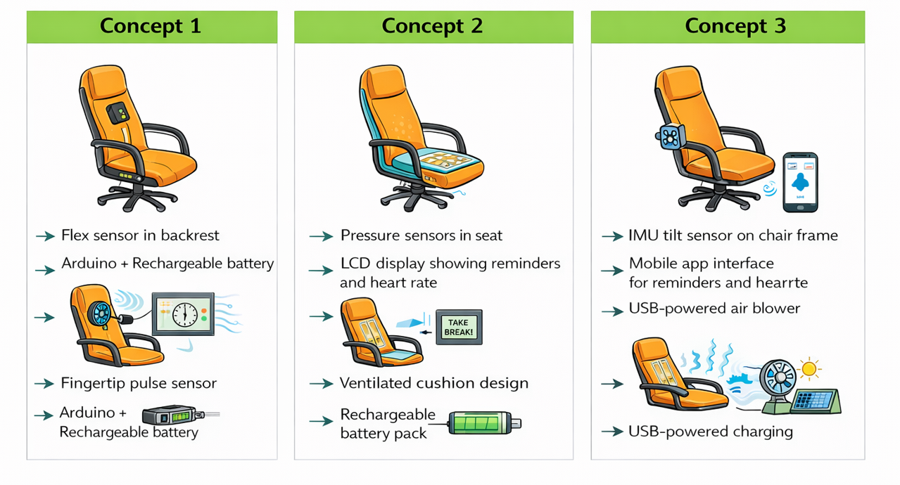
CONCEPT GENERATION

Slide 17
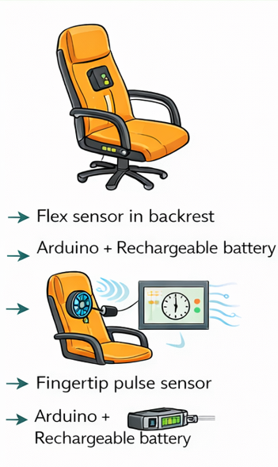
CONCEPT-1 : BASIC SENSOR BASED SMART CHAIR
Main Features
Flex sensor placed in backrest for posture detection
Arduino microcontroller as control unit
Fingertip pulse sensor for heart rate
Small DC cooling fan mounted at back
Buzzer alarm for sedentary and water reminder
Rechargeable battery supply
Working Principle
When user sits
Flex sensor measures spine bending
→ Arduino reads analog signal
→ If posture wrong → buzzer alarm
Pulse sensor
→ detects blood flow variation
→ Arduino calculates BPM
→ basic health monitoring
Timer inside Arduino
→ gives break reminder & water reminder
Fan
→ improves air circulation
→ increases comfort

Slide 18
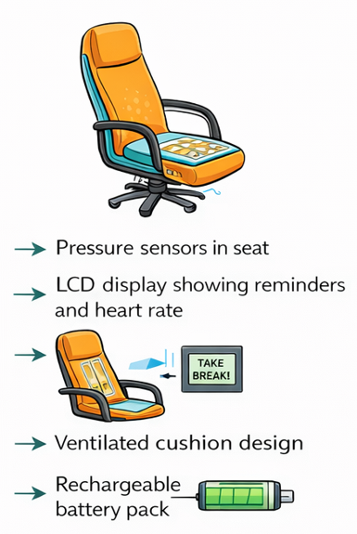
CONCEPT-2 : CUSHION SENSOR + DISPLAY BASED SMART CHAIR
This concept focuses on better ergonomics + user interaction.
Main Features
Pressure sensors embedded in seat cushion
LCD display showing reminders and heart rate
Ventilated cushion design for passive cooling
Rechargeable battery pack
Working Principle
Pressure sensors
→ detect uneven weight distribution
→ identify poor sitting posture
LCD display
→ shows messages like
“Sit Straight”
“Take Break”
“Drink Water”

Slide 19
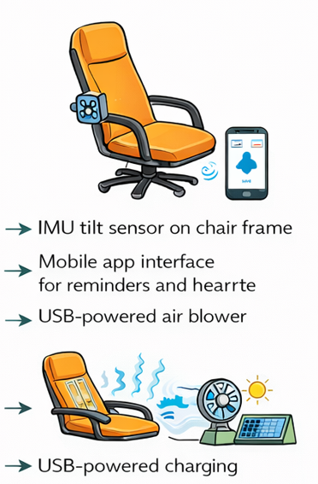
CONCEPT-3 : ADVANCED SMART CONNECTED CHAIR
This concept focuses on modern IoT based smart ergonomic furniture.
Main Features
IMU tilt sensor mounted on chair frame
Mobile app connectivity for alerts
USB powered air blower cooling
Solar assisted charging system
Working Principle
IMU sensor
→ detects chair tilt angle
→ determines body posture dynamically
Mobile app
→ sends notification
“Wrong posture”
“Time to move”
USB blower
→ provides strong cooling airflow
Solar charging
→ improves energy efficiency

Slide 20
CONCEPT SELECTION (AHP)
Decision matrix
Criteria | Cost | Fabrication | Performance | Comfort | Complexity
Cost | 1 | 2 | 3 | 3 | 4
Fabrication | 1/2 | 1 | 2 | 2 | 3
Performance | 1/3 | 1/2 | 1 | 2 | 2
Comfort | 1/3 | 1/2 | 1/2 | 1 | 2
Complexity | 1/4 | 1/3 | 1/2 | 1/2 | 1
 | 2.416 | 5.33 | 7 | 8.5 | 12

Slide 21
Priority vector
Criteria | Cost | Fabrication | Performance | Comfort | Complexity | Priority
Cost | 0.513 | 0.462 | 0.428 | 0.352 | 0.333 | 0.417
Fabrication | 0.206 | 0.231 | 0.285 | 0.235 | 0.25 | 0.241
Performance | 0.137 | 0.115 | 0.142 | 0.235 | 0.166 | 0.159
Comfort | 0.137 | 0.115 | 0.071 | 0.117 | 0.166 | 0.121
Complexity | 0.103 | 0.076 | 0.071 | 0.058 | 0.083 | 0.064

Slide 22
C1: Basic Sensor Chair C2: Cushion + Display Chair C3: Advanced Smart IoT Chair
Cost | C1 | C2 | C3
C1 | 1 | 3 | 5
C2 | 1/3 | 1 | 3
C3 | 1/5 | 1/3 | 1
Fabrication | C1 | C2 | C3
C1 | 1 | 4 | 5
C2 | 1/4 | 1 | 3
C3 | 1/5 | 1/3 | 1
Performance | C1 | C2 | C3
C1 | 1 | 1/3 | 1/5
C2 | 3 | 1 | 1/3
C3 | 5 | 3 | 1

Slide 23
Comfort | C1 | C2 | C3
C1 | 1 | 1/5 | 1/3
C2 | 5 | 1 | 3
C3 | 3 | 1/3 | 1
Complexity | C1 | C2 | C3
C1 | 1 | 3 | 5
C2 | 1/3 | 1 | 3
C3 | 1/5 | 1/3 | 1

Slide 24
Cost | C1 | C2 | C3 | Priority
C1 | 0.652 | 0.692 | 0.555 | 0.633
C2 | 0.217 | 0.230 | 0.333 | 0.260
C3 | 0.130 | 0.076 | 0.111 | 0.105
fabrication | C1 | C2 | C3 | Priority
C1 | 0.689 | 0.750 | 0.555 | 0.664
C2 | 0.172 | 0.187 | 0.333 | 0.230
C3 | 0.137 | 0.062 | 0.111 | 0.103
Performance | C1 | C2 | C3 | Priority
C1 | 0.111 | 0.076 | 0.375 | 0.187
C2 | 0.333 | 0.230 | 0.848 | 0.470
C3 | 0.555 | 0.692 | 0.652 | 0.633

Slide 25
Comfort | C1 | C2 | C3 | Priority
C1 | 0.111 | 0.130 | 0.076 | 0.105
C2 | 0.555 | 0.652 | 0.692 | 0.633
C3 | 0.333 | 0.217 | 0.230 | 0.390
Complexity | C1 | C2 | C3 | Priority
C1 | 0.652 | 0.692 | 0.555 | 0.633
C2 | 0.217 | 0.230 | 0.333 | 0.390
C3 | 0.130 | 0.076 | 0.111 | 0.105

Slide 26
Final Priority Vector
Criteria | C1 | C2 | C3
Cost | 0.298 | 0.108 | 0.043
Fabrication | 0.160 | 0.055 | 0.024
Performance | 0.029 | 0.074 | 0.100
Comfort | 0.012 | 0.076 | 0.047
Complexity | 0.040 | 0.024 | 0.006
 | 0.539 | 0.337 | 0.222
From the AHP analysis,
Concept-1 (Basic Sensor Based Smart Health Monitoring Chair) has obtained the highest priority among all design alternatives. It is preferred due to its low cost, simple fabrication process, and adequate functional performance suitable for a student prototype.
Although Concept-2 and Concept-3 offer improved comfort and advanced smart features, they involve higher complexity and cost.
Therefore, Concept-1 is selected as the final design for the Smart Health Monitoring Chair project.

Slide 27
DESIGN FOR MANUFACTURING
Selected components:
ESP32 microcontroller
MAX30100 sensor
FSR406 force sensor
Ultrasonic sensor (HC-SR04)
OLED display
LM2596 converter
DFM is applied through:
Component selection
Ease of integration

Slide 28
12v dc adaptor
OLED
display
LM2596 dc-dc buck convertor
ESP32 microcontroller
Sensor unit
Alert unit
Transistor with Buzzer
Green led
Red led
MAX30100 sensor
Heart beat & SPO2
FRS406
Force sensor
Ultrasonic sensor

Slide 29
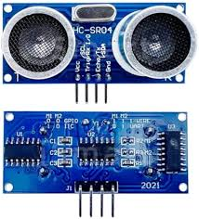
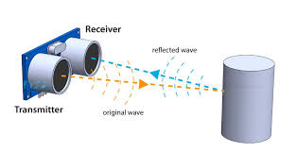
Ultrasonic sensor HC-SR04
Ultrasonic TRIG → GPIO 5
Ultrasonic ECHO → GPIO 18

Slide 30
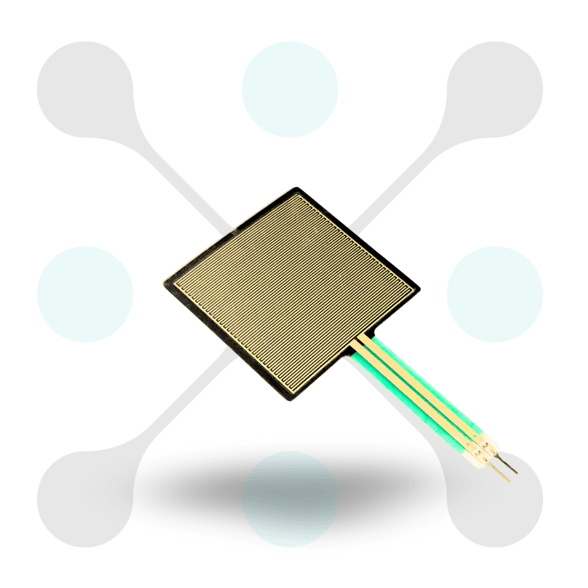
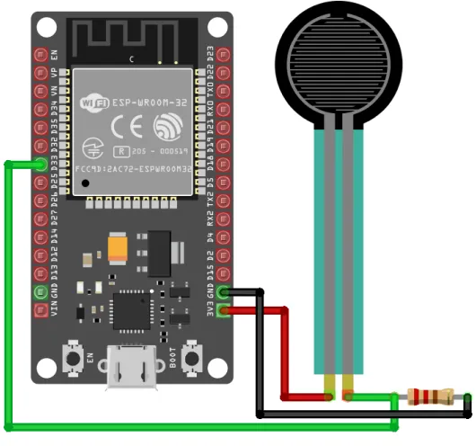
Force sensor
FSR Sensor → GPIO 34

Slide 31
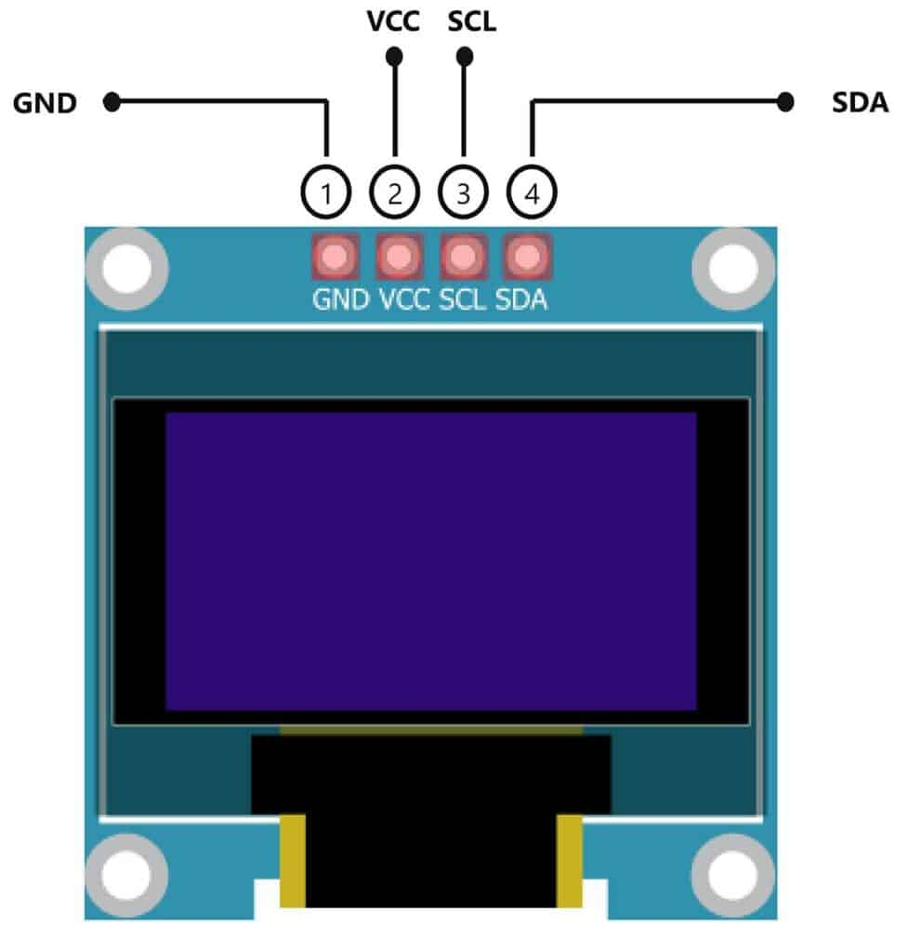
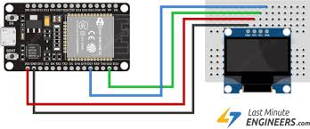
OLED display module
OLED SDA → GPIO 16
OLED SCL → GPIO 17

Slide 32
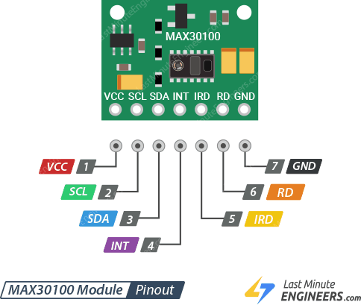
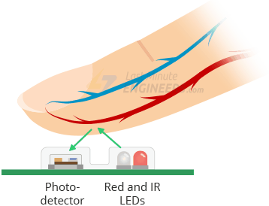
https://lastminuteengineers.com/max30100-pulse-oximeter-heart-rate-sensor-arduino-tutorial/
For more details
MAX30100 SDA → GPIO 21
MAX30100 SCL → GPIO 22
MAX30100 Pulse Oximeter and Heart Rate Sensor

Slide 33
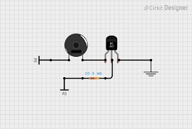
Buzzer
BUZZER → GPIO 23 + GND

Slide 34
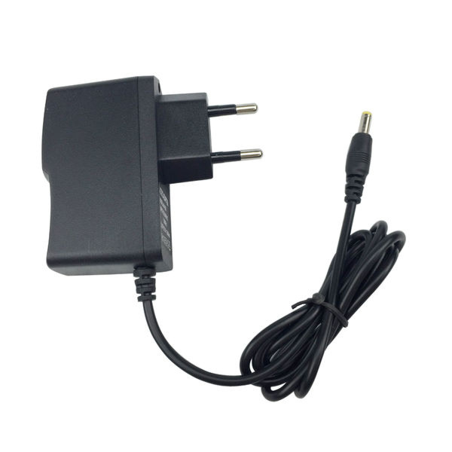
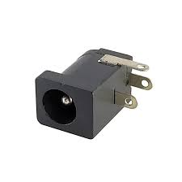
12v Adaptor with dc jack

Slide 35
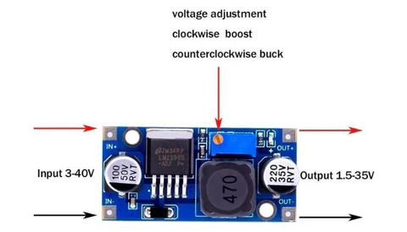
Dc supply convertor
LM2596 dc-dc buck convertor
12v dc to 5v dc

Slide 36
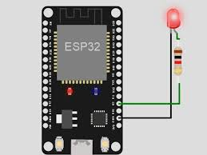
Led green and red
LED1 → GPIO 25 + 220Ω + GND
LED2 → GPIO 26 + 220Ω + GND

Slide 37
Pin connection
EASE OF INTEGRATION
All components are:
  Compatible with ESP32
  Operate at 3.3V / 5V
Standard communication:
  I2C (OLED, MAX30100)
  Digital pins (Ultrasonic, LEDs)
FSR Sensor → GPIO 34
Ultrasonic TRIG → GPIO 5
Ultrasonic ECHO → GPIO 18
LED1 (Green) → GPIO 25
LED2 (Red) → GPIO 26
BUZZER → GPIO 23
OLED SDA → GPIO 16
OLED SCL → GPIO 17
MAX30100 SDA → GPIO 21
MAX30100 SCL → GPIO 22
With ESP32 microcontroller
LED1 → GPIO 25 + 220Ω + GND
LED2 → GPIO 26 + 220Ω + GND

Slide 38
Supply
OLED → 3.3V
MAX30100 → 3.3V
FSR → 3.3V
LED1 → GPIO 25 + 220Ω + GND
LED2 → GPIO 26 + 220Ω + GND
BUZZER → GPIO 23 + GND
HC-SR04 → 5V + GND
To sensor and hardware
POWER DESIGN (DFM ASPECT)
Single power source:
  12V adapter
Converted using:
  LM2596 (12V → 5V)
Distributed to:
  ESP32
  Sensors

Slide 39
DESIGN FOR ASSEMBLY
APPROACH IN OUR PROJECT
No manufacturing → only assembly of components
Focus on:
  Easy wiring
  Proper placement of sensors
  Modular design
MODULAR DESIGN
System divided into:
Sensor unit
Control unit (ESP32)
Output/alert unit
SIMPLIFIED CONNECTIONS
From your design:
I2C → OLED + MAX30100
Digital → Ultrasonic
Analog → FSR
Reduces wiring complexity
EASY COMPONENT MOUNTING
FSR → inside seat cushion
Ultrasonic → backrest
OLED → front panel
Fixed positions → no alignment issues
ERROR REDUCTION
Color-coded wires
Fixed GPIO mapping
Prevents wrong connections

Slide 40
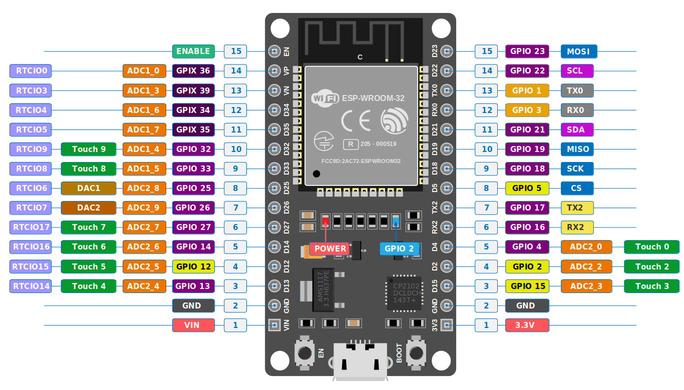

Slide 41
DESIGN FOR RELIABILITY
APPROACH IN OUR PROJECT
Use of tested and reliable modules
Stable electrical design
POWER RELIABILITY
LM2596 provides stable voltage
Proper 3.3V & 5V distribution
Prevents system failure
ELECTRICAL SAFETY
Voltage divider for ultrasonic ECHO
Common grounding
Protects ESP32
SENSOR RELIABILITY
MAX30100 → stable health data
FSR → calibrated for pressure
Ultrasonic → filtered readings
FAULT HANDLING
If sensor fails → system continues
Error messages can be displayed

Slide 42
BILL OF MATERIAL
Stage/Component | Description/Material | Estimated Cost (INR) per Unit
ESP32 Microcontroller | WiFi + Bluetooth development board | 350
MAX30100 Sensor | Heart rate & SpO₂ sensor module | 180
FSR406 Force Sensor | Pressure sensing resistor | 250
Ultrasonic Sensor (HC-SR04) | Distance measurement module | 70
OLED Display | 0.96” I2C display module | 150
LM2596 Converter | DC-DC buck converter (12V → 5V) | 80
Buzzer + Transistor | Alert system components | 40
LEDs (Red + Green | Indicator LEDs + resistors | 20
Connecting Wires | jumper wires, connectors | 50
Breadboard/PCB | Prototyping board | 80
Power Supply | 12V adapter with DC jack | 150
Chair (Base Structure) | Purchased ergonomic chair | 1200

Slide 43
Cost Additions
Category | Description | Cost(INR)
Assembly/Labor | Writing , fixing sensor | 150
Overhead | Testing , minor tools | 100
Logistics | Transport of components | 100
Miscellaneous | Damage , replacement , wastage | 80
Final Cost Summary
Category | Cost(INR)
Subtotal(Ex-Factory) | 2900
Distributor Margin(-10%) | 290
Retailer Margin(-15%) | 435
GST and Taxes(-12%) | 350
MRP(final price) | 3975

